Slide 1


Analysis of Social Buzz’s content categories

Slide 2


Today's agenda
Project recap
Problem
The Analytics team
Process
Insights &
Summary

Slide 3

Social Buzz is a fast growing technology
unicorn that need to adapt quickly to it's
global scale. Accenture has begun a 3 month
POC focusing on these tasks:
•An audit of Social Buzz's big data practice
•Recommendations for a successful IPO
•Analysis to (nd Social Buzz's top 5 most
popular categories of content
Social Buzz, a rapidly expanding tech unicorn, needs to adapt swiftly to its global growth. To address this, Accenture has initiated a 3-month proof of concept (poc) project, focusing on several key tasks.
•An audit of Social Buzz's big data practice.
•Recommendations for a successful IPO.
•Data Analysis to find Social Buzz's top 5 most popular categories of content.
Project Recap

Slide 4

Problem
Social Buzz receives a massive scale of diverse content daily, including text, images, videos, and GIFs, totaling over 100,000 pieces.
This unstructured data requires advanced and costly technology to process and maintain.
The following requirements need to be met:
Data Integration: Merge the sample data set tables into a unified dataset.
Content Analysis: Conduct an analysis of the content categories to identify the top 5 categories with the highest aggregate popularity.

Slide 5
Andrew Fleming
Chief Technology Architect
The Analytics Team
Marcus Rompton
Senior Principal
Tulika Das
Data Analyst

Slide 6
Data Understanding
Process
1
Pandas : Python Library
Data Cleaning
2
Data Modelling
3
Data Analysis
4
Tableau
Insights
5

Slide 7

Insights
16
75K
January
Animals
Unique Categories
Category With Highest Score
Month with
Most posts

Slide 8
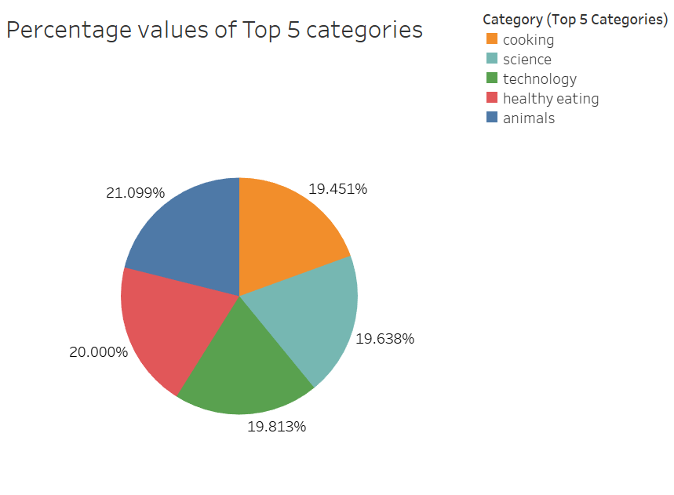
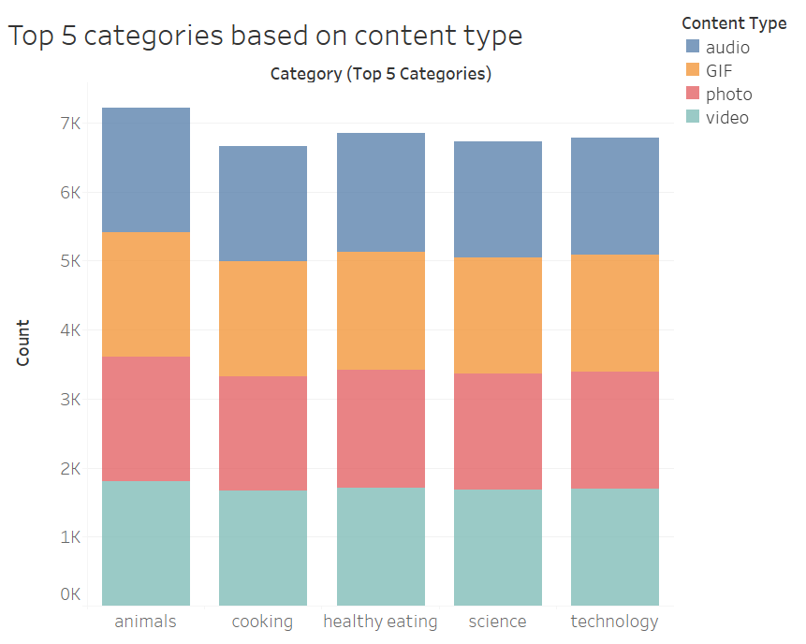

Slide 9
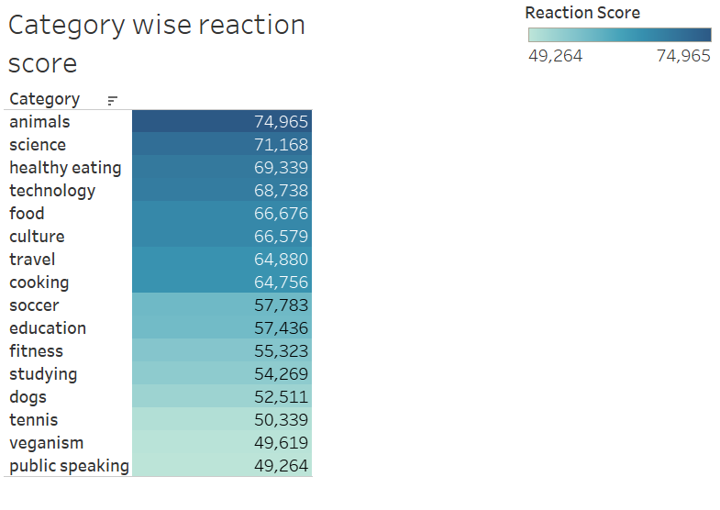
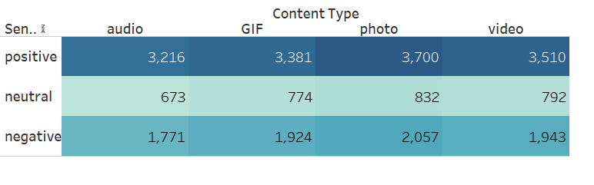

Slide 10
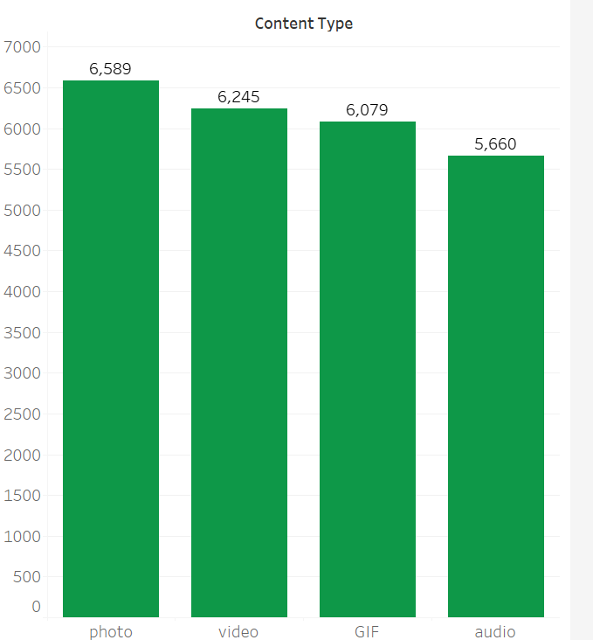
From the Bar chart, it is observed that photos have the highest posts with a total of 6,589 posts, followed by videos with a total of 6,245 posts, then GIF with a total of 6,079 posts, and lastly audio with a total of 5,660 posts.

Slide 11

Most popular content category is animals and least one is public speaking. So I would recommend you to keep creating content according to the popular category.
Photos received highest positive sentiments among all the contents.
Summary
The popularity of technology-related content is a testament to users' interest in the field. Partnering with prominent tech companies such as Google, OpenAI, Microsoft, Amazon etc. could significantly boost user engagement and further solidify the Social Buzz’s position in the tech space.

Slide 12
Thank You!
ANY QUESTIONS?

